Slide 1
Philippians 1:1-11
(English Standard Version)

Slide 2
(ESV) 1 Paul and Timothy, servants of Christ Jesus,
To all the saints in Christ Jesus who are at Philippi, with the overseers and deacons:
² Grace to you and peace from God our Father and the Lord Jesus Christ.
³ I thank my God in all my remembrance of you, ⁴ always in every prayer of mine for you all making my prayer with joy, ⁵ because of your partnership in the gospel from the first day until now. ⁶ And I am sure of this, that he who began a good work in you will bring it to completion at the day of Jesus Christ.

Slide 3
⁷ It is right for me to feel this way about you all, because I hold you in my heart, for you are all partakers with me of grace, both in my imprisonment and in the defense and confirmation of the gospel. ⁸ For God is my witness, how I yearn for you all with the affection of Christ Jesus. ⁹ And it is my prayer that your love may abound more and more, with knowledge and all discernment, ¹⁰ so that you may approve what is excellent, and so be pure and blameless for the day of Christ, ¹¹ filled with the fruit of righteousness that comes through Jesus Christ, to the glory and praise of God.

Slide 4
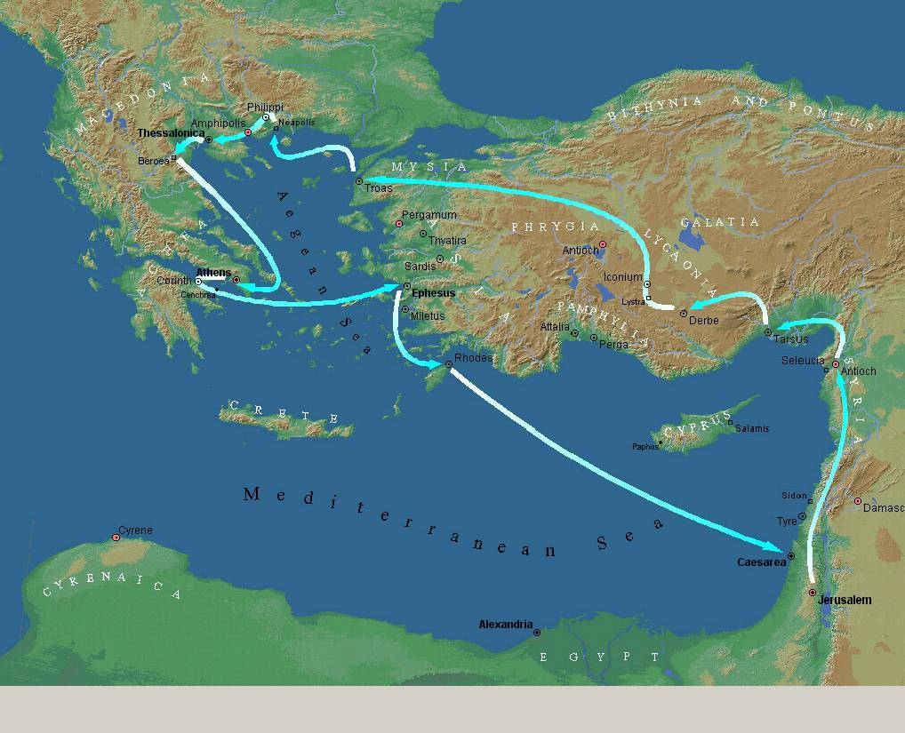
Thessalonica
Philippi
Troas
Macedonia
Athens
Phrygia
Galatia
Corinth
Antioch
Jerusalem

Slide 5
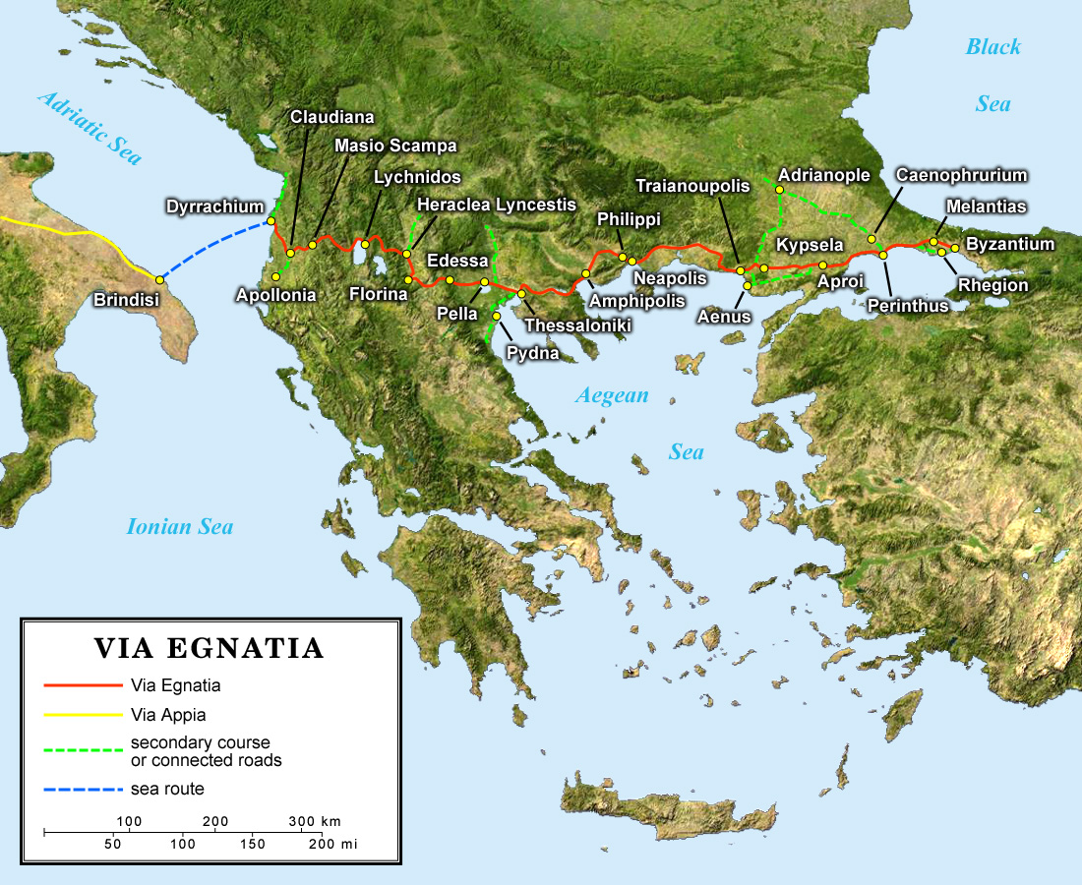
Philippi
Bulgaria
Italy
Greece
Turkey

Slide 6
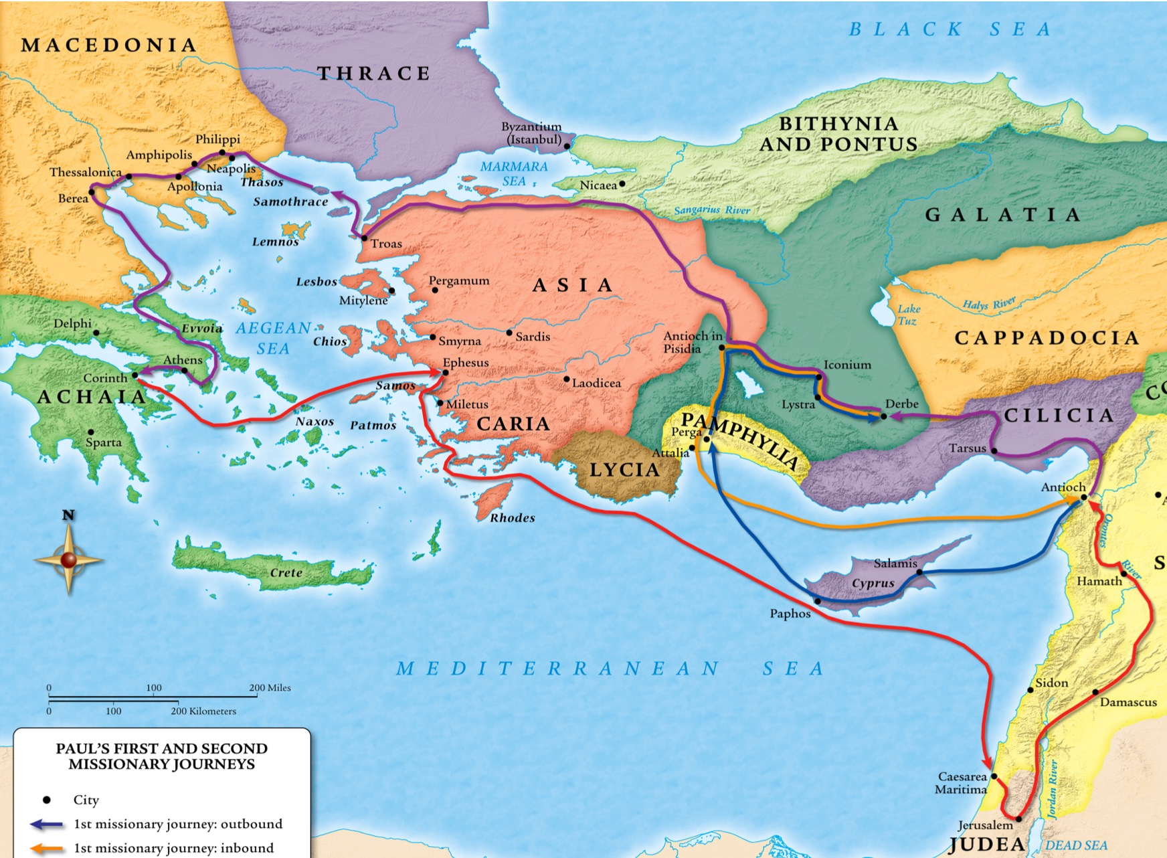
Philippi

Slide 7
The church at Philippi – Close to Paul’s Heart
The first major place he preached the Gospel in Europe
Guided by the Holy Spirit to Ephesus
Experienced the Power of God in miraculous ways, as God built His church
When God gives a word/dream/vision, usually its purpose is to give an assurance of call
^{Philippians (ESV)} 1 Paul and Timothy, servants of Christ Jesus, To all the saints in Christ Jesus who are at Philippi, with the overseers and deacons:
Who we are in Christ
Paul a spiritual hero, but sees himself as a slave of Christ
To be a slave of Christ is a privileged position
Saints (Holy ones).
Holy, because our address is “in Christ”
⁶ And I am sure of this, that he who began a good work in you will bring it to completion at the day of Jesus Christ.
Even if we don’t feel very ‘saintly’, God will continue transforming us until Christ returns
Leaders in the church are no more important / holy than the whole church
Grace & Peace
The Bread & Butter of Disciples of Jesus

Slide 8
(ESV) 1 Paul and Timothy, servants of Christ Jesus,
To all the saints in Christ Jesus who are at Philippi, with the overseers and deacons:
² Grace to you and peace from God our Father and the Lord Jesus Christ.
³ I thank my God in all my remembrance of you, ⁴ always in every prayer of mine for you all making my prayer with joy, ⁵ because of your partnership in the gospel from the first day until now. ⁶ And I am sure of this, that he who began a good work in you will bring it to completion at the day of Jesus Christ. ⁷ It is right for me to feel this way about you all, because I hold you in my heart, for you are all partakers with me of grace, both in my imprisonment and in the defense and confirmation of the gospel. ⁸ For God is my witness, how I yearn for you all with the affection of Christ Jesus. ⁹ And it is my prayer that your love may abound more and more, with knowledge and all discernment, ¹⁰ so that you may approve what is excellent, and so be pure and blameless for the day of Christ, ¹¹ filled with the fruit of righteousness that comes through Jesus Christ, to the glory and praise of God.

Slide 9
The church at Philippi – Close to Paul’s Heart
When God gives a word/dream/vision, usually its purpose is to give an assurance of call
Who we are in Christ
To be a slave of Christ is a privileged position
Saints (Holy ones).
Holy, because our address is “in Christ”
Grace & Peace
The Bread & Butter of Disciples of Jesus – contentment in adversity
your partnership in the gospel from the first day until now.
Partners in Ministry (Not consumers of ministry)
Partners in ministry from when first saved. New Christians are partners in the Gospel too!!!
Financial support; Prayer support; Active in sharing the Gospel
I hold you in my heart, for you are all partakers with me of grace, both in my imprisonment and in the defense and confirmation of the gospel.
We’re all in this journey of Grace Together – The church a Fellowship of Grace
Support one another; Love one another; build one another up; In ministry together
Supporting the persecuted church (Christians who suffer/jailed for the sake of Christ)
Share in the defence of the Gospel. The Gospel is under attack (to twist/corrupt it)
Confirmation of the Gospel. To demonstrate that it is true.
Love; fellowship; purity; righteousness; holiness

Slide 10
⁹ And it is my prayer that your love may abound more and more, with knowledge and all discernment, ¹⁰ so that you may approve what is excellent, and so be pure and blameless for the day of Christ, ¹¹ filled with the fruit of righteousness that comes through Jesus Christ, to the glory and praise of God.

